Slide 1

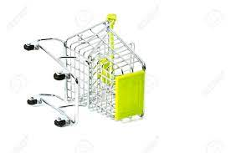
Understanding OCCx Cart Drop Off
Phase II Quant
DRI: Kelly Peterson
Date: July 31 2023

Slide 2



Research Approach
Phase I: Qualitative interviews
1:1 Interviews with 8 Cx that had dropped off from their cart in the past 24 hours
Insights can be found here
Phase II: Online Survey
10 min online survey with 249 OCCx who had dropped off from their cart in the past 24 hours
Survey can be found here
The research brief can be found here.
Notes:
James to link to failed session

Slide 3
Research Goals
Understand and size the top reasons for cart drop off to identify ways to maximize affordability efforts
Key questions include…
1.
What are the top reasons why OCCx drop off from the cart? How large is each reason?
2.
Who are the Cx that are dropping off? Does their demographic or attitudinal profile differ by reason for drop off?
3.
What can DoorDash do to plug the leaky bucket?

Slide 4
Drop Off Experiences

Slide 5
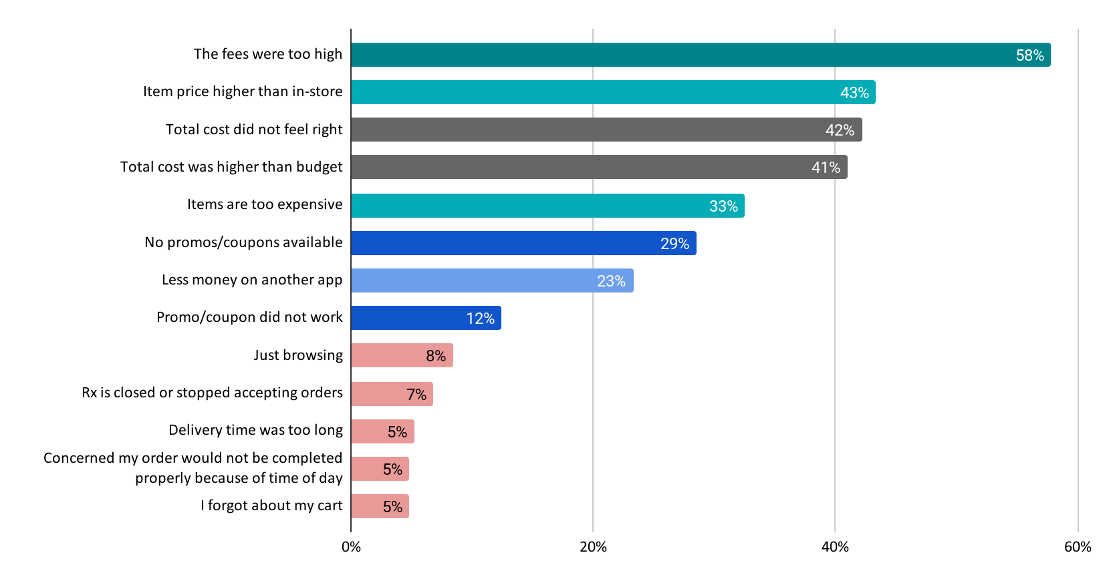
Fees and item prices confirmed as top reason for drop off, overall budget is an important consideration factor
Reasons why OCCx dropped from cart
29% of OCCx selected fees as most important reason they did not place order
21% of OCCx overall cost was most important reason they did not place order

Slide 6



Fees
Items are higher than in-store
Overall cost
Too many fees. Even with a huge discount it was not worth it.
increased prices on items that are higher than other delivery services were too much
Didn't have enough on my card to cover it all
Once the service fees are equal to or more then I was planning on tipping I start to second guess the transaction.
It was cheaper to order straight from the website which was also offering free delivery for that day.
I looked at the final price and decided it wasn't in my budget right now
No coupons and pricing was a lot different that restaurants
Too many fees that increased the food about by 15 dollars
I thought about it again, and didn't have the funds to actually spend over $30 for 1 dessert.
I placed the order through the restaurants app because it was cheaper for the same products compared to ordering through Door Dash.
Fees added too much cost to the meal, and there were no promotions.
I didn’t want to pay more than $22 not including tip

Slide 7
Overlap between cost related drop reasons is high
Fees
Item prices
6%
12%
11%
41%
11%
9%
Overall cost
10%

Slide 8
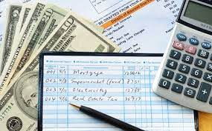
At the end of the day the total matters, regardless if the Cx has a specific budget or not
88%
Of OCCx who dropped off say they have a specific budget or general amount of money they aim to keep their order below
Recommendation: Explore cart totals for converted vs. drop off Cx to define required threshold for target OC, Dormant & Churned Cx.

Slide 9



Selection for ToDP should include quality Rx that offer options within Cx price range after tip, tax, fees & discounts are applied
OCCx acceptable total/budget by meal:
Breakfast
Lunch
Dinner
$12.00
$19.00
$28.00

Slide 10



Cx acknowledge that drop off happens fairly frequently
How frequently do you put items in your cart on DoorDash and then not place an order?
Almost every order | 15%
Every few orders | 59%
Rarely | 26%
Never | 0%
Top drivers of drop off align with most frequent drivers of drop off
Cx who stated that fees or total cost were their primary reason were more likely to drop off every few orders (64% and 68%)
Cx who stated that higher item prices were the primary reason for drop off were more likely drop off almost every order (20%)

Slide 11



Half of the time Cx cook at home, guilt remains a major factor
Cx that drop off due to high fees are more likely to order from an Rx or another app
Cx that drop off due to item prices or total cost are more likely to cook at home
Few Cx (less than 10%) end up going out to eat at a restaurant
45% of OCCx who drop off from their cart end up cooking at home
28% order directly from Rx
19% order from another app

Slide 12
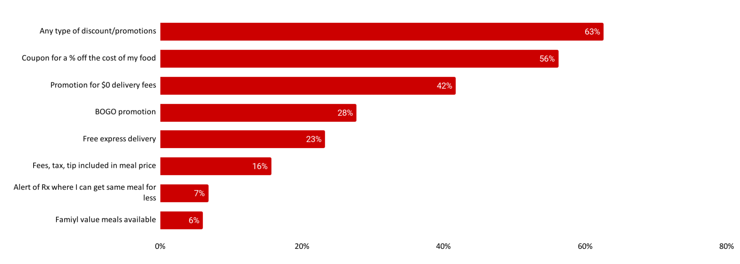

Cx say a discount will help reduce drop off; subtext from qual: the promo has to be worth it
Which of the following would have made you more likely to place the order?
Avg acceptable cost: $17

Slide 13





Opportunity for us to quantify value (time saved) along with savings
Time saved not having to cook | Time saved driving/walking for pickup | Not having to go out in weather conditions | I don’t have to meal prep | Support at the end of the busy day
59% | 50% | 37% | 33% | 25%

Slide 14
Cx Profiles by Drop Off Driver

Slide 15


Primary Reason: Fees
To reduce Cx with drop off for fees sensitive Cx we need to make sure we are highlighting lower cost restaurants along with low fees, particularly for lunch.
These Cx are more likely to go to another app, experimenting with value based pushed notifications in the moment may help them get back to the app.
Who are they?
More likely to be single individual HH
More likely to order for self & others
Skews city
What are their ordering behaviors?
Order takeout for lunch & dinner
Order delivery from an app a few times a month
Less likely to have a specific budget
Feel a “fair” overall price is lower than other drop off Cx ($10 on average)
Drop off from DoorDash every few orders, likely to place order on different app

Slide 16


Primary Reason: Items cost more than in-store
This group needs more reason to remove the guilt of ordering and allow they to get takeout vs. cooking at home. Consider highlighting Rx that offer value/family meals in addition to ToDP.
Additionally, these Cx may benefit from ToDP + Double Dash. Linking post order savings comms with ability to continue to save for the whole family may help.
Who are they?
Tend to be 35+
Largest size household than other drop off segments (3.9 in HH on avg)
Likely to have children in the household
What are their ordering behaviors?
Order delivery a few times a month overall, often cooks at home
Even split between ordering for just themselves vs. a group/full household
State they are likely to drop off almost every order and end up cooking at home

Slide 17


Primary Reason: Overall cost/budget
To reduce Cx with drop off for overall cost/budget we must ensure we have low item/low inflation Rx in selection.
These Cx are more likely to go to another app, experimenting with value based pushed notifications in the moment may help them get back to the app.
Who are they?
Skew younger (18-24)
Skew suburban
What are their ordering behaviors?
Primarily cook at home
Typically ordering only for self
Orders both lunch & dinner on DoorDash
Has the tightest budget overall, especially for dinner
Likely to drop off every few orders, will look to other apps

Slide 18
How can we combat drop off

Slide 19


KP’s Recommendations
Offensive strategies
Selection/budget capping (look at by single meal vs. multi-meal orders)
Dayparting Rx highlights in carousels by budget
Reinforcing value in addition to savings
  Time/effort/energy saved not having to cook
Defensive strategies
Stronger drop off notifications:
  Try ToDP Rx to get $0 delivery and 10% off
  You can get your meal for $5 less at XX Rx (click to built cart)
  Place your order in the next X and get Y
Ability to promo stack when drop is high risk

Slide 20
Upcoming Research

Slide 21
PAD UXR Summer Priorities
Project | Key Research Question | Status | Estimated timing
ToDP convert vs. non-convert | What is working, what is not working? How can we continue to evolve ToDP to best meet Cx needs? | To be shared in next biweekly readout | Early August
Defining & communicating value beyond savings | How can we communicate the positive factors of using DoorDash beyond/in addition to savings to increase perceived value? | Going to field shortly | Early Aug
Rotation Cx Pulse | Pulse check with Cx when rotation V1 experiments go live. Does it make sense? How are they understanding the concept of rotation? | Scoping | Mid Aug
Project E.T. Concept Tests | How do Cx feel about project E.T.? Is it clear, exciting, impactful and unique? | Scoping | Early Sept
Substitutability & Mx Selection | What are the trade-offs and factors that Cx consider when selecting a Mx. How might they think through other solutions when their initial Mx or item is not available? | Working on timing with analytics | Early Sept
Padding Cx sentiment | Are Cx aware when we pad timing on orders? Do they realize they are making a tradeoff between price and cost? Is time the main reason why they drop off cancel? | Scoping | End of Aug
Note: KP OOO 8/4-8/9

